Slide 1
Resources
Video (recording of presentation)
https://www.youtube.com/watch?v=65G5xkWXTTk&ab_channel=mohammadrkieh
PDF (notes in pdf format)
Notes:
Video : https://www.youtube.com/watch?v=65G5xkWXTTk pdf: https://drive.google.com/file/d/1z29PIrXRIYvjWEL3Cpk4adpbEQpEsrnh/view

Slide 2
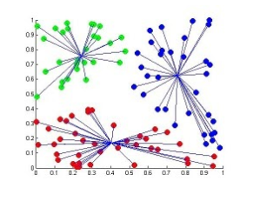
Fuzzy Clustering
Mohammad Rkieh (104928868)
Instructor: Dr. Yasser Alginahi
Date: 3rd of November, 2023

Slide 3
Table of Contents
Introduction
Hard Clustering Limitation & Solution
Fuzzy C-Means (FCM) algorithm
Applications
Mathematical Concept
Pseudocode
Code (Python)
Evaluation

Slide 4
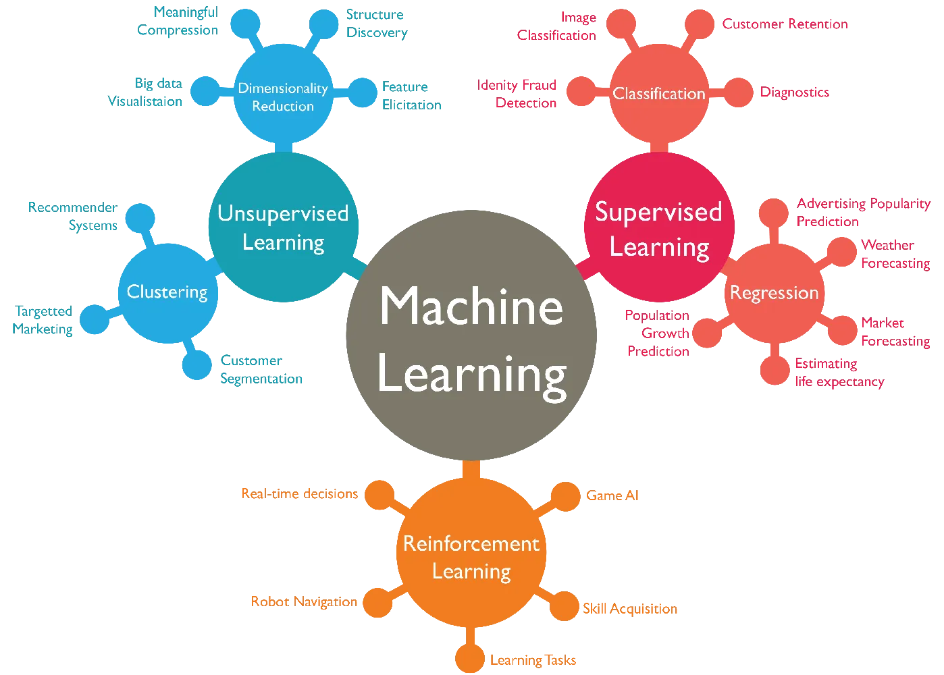
Introduction
Unsupervised- learning
Clustering
Machine Learning Diagram [1]

Slide 5
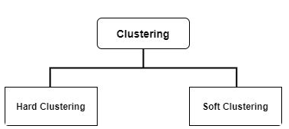
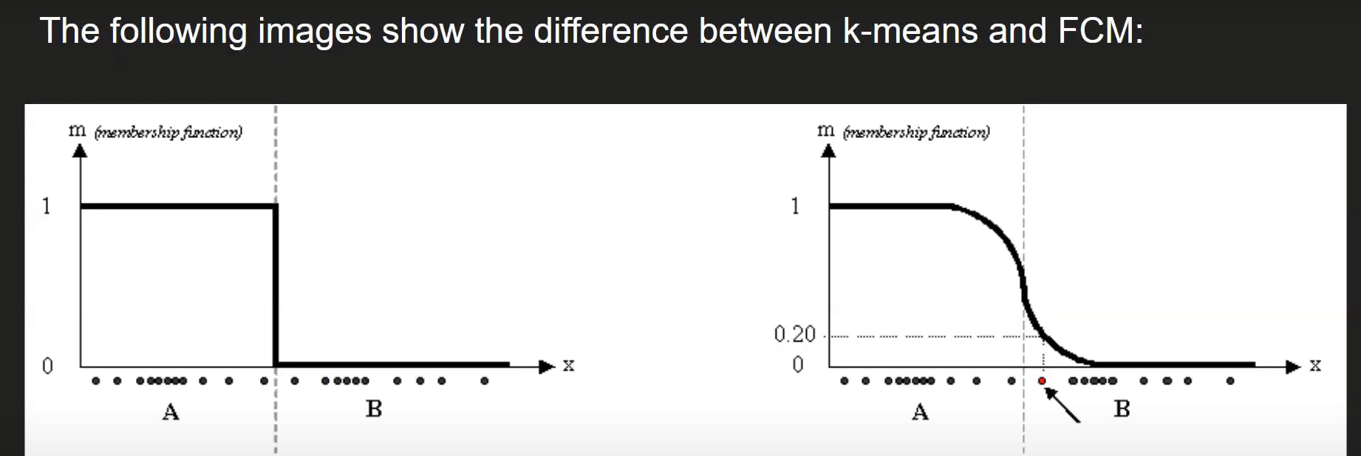

Limitation of Hard Clustering
Hard Clustering (k-means)
Hard Clustering Membership Function [2]

Slide 6
Solution
Soft Clustering (fuzzy)
Soft Clustering Membership Function [2]

Slide 7

Fuzzy C-Means (FCM) algorithm
Flexible clustering algorithm
Soft Clustering version of K-Means

Slide 8
Applications
Pattern Recognition
Marketing
Medical Diagnosis
Image Segmentation

Slide 9
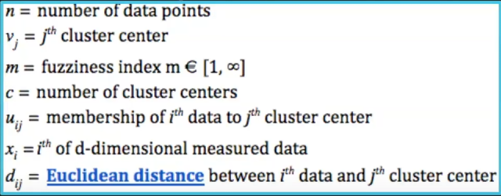
Mathematical Concept - Variables

Slide 10
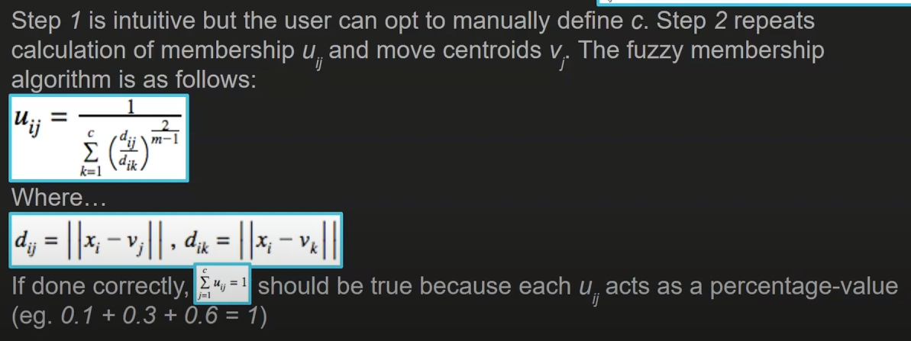
Mathematical Concept – Steps (1)
Mathematical Concept Steps [5]

Slide 11
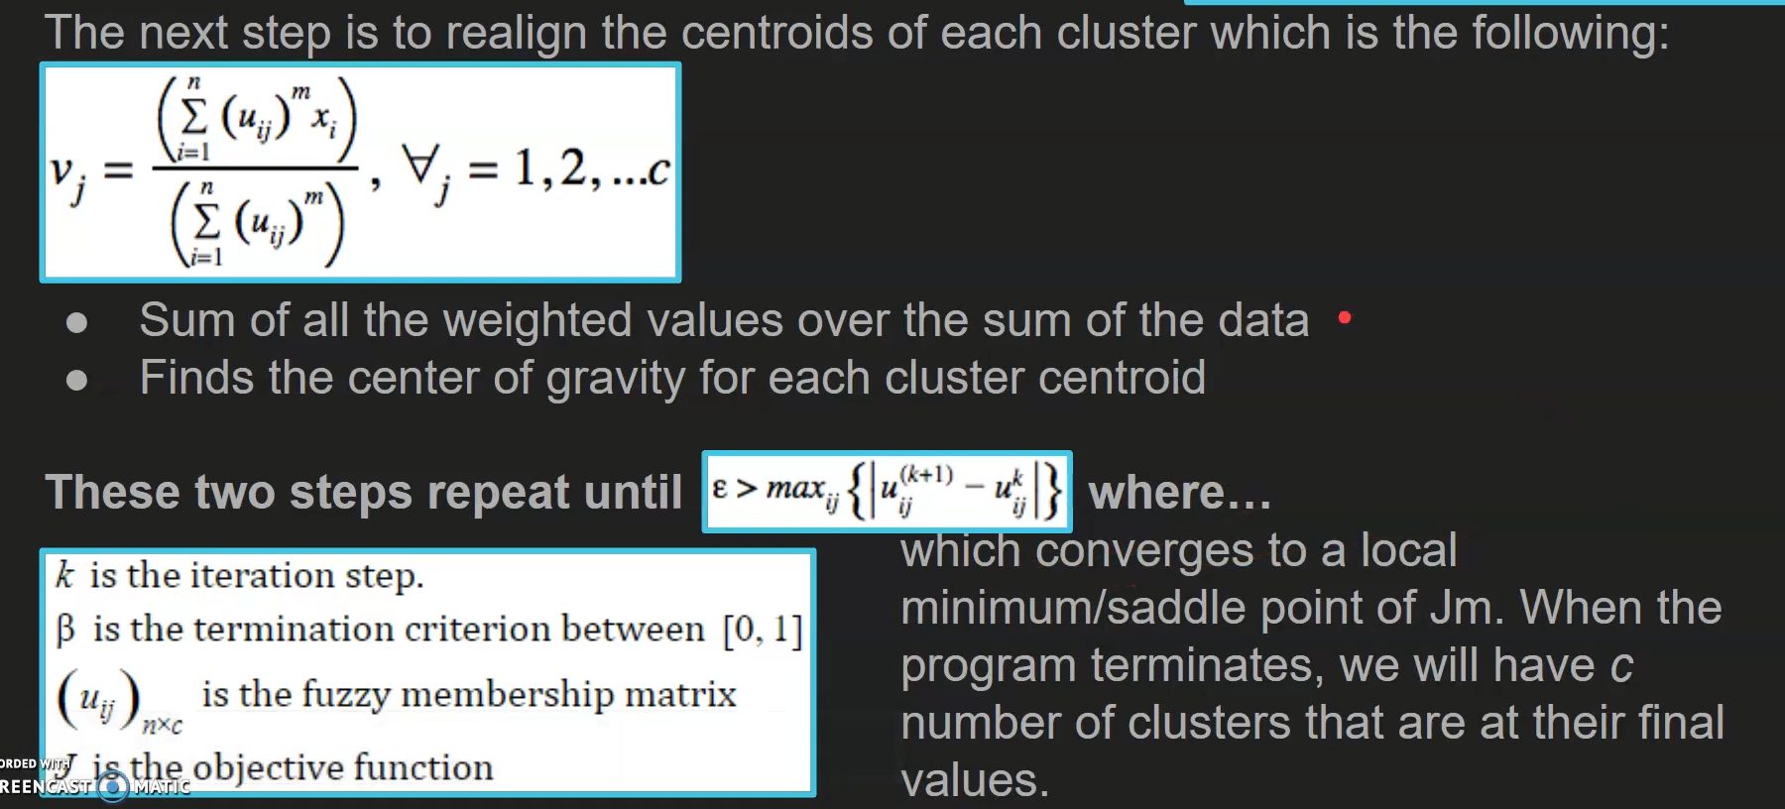
Mathematical Concept – Steps (2)
Mathematical Concept Steps [5]

Slide 12
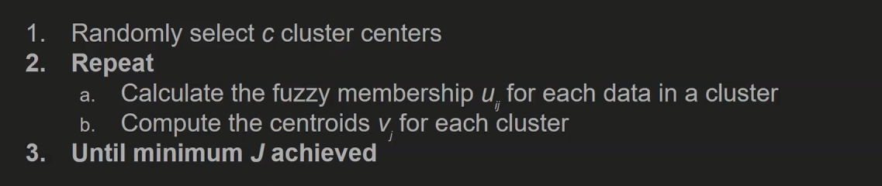
Pseudocode

Slide 13
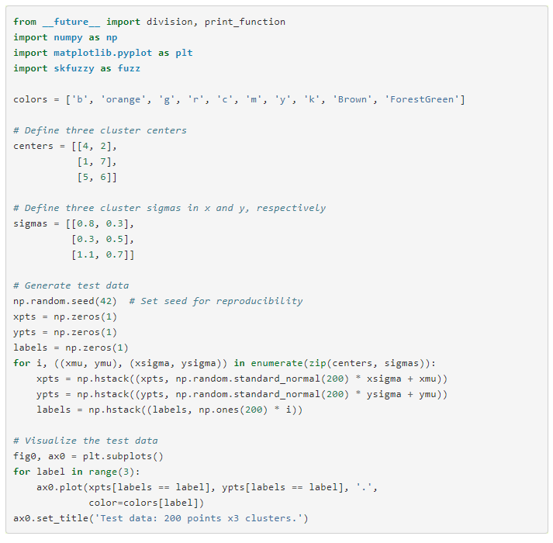
Code
Skfuzz library
Fuzzy Clustering Python Implementation [1]
Notes:
https://www.youtube.com/watch?v=W-3ZYGmLJ-4&t=127s

Slide 14

Advantages
Flexibility
Robustness
No preset number of clusters

Slide 15
Disadvantages
Complexity
Model selection
Deciding on the number of clusters

Slide 16
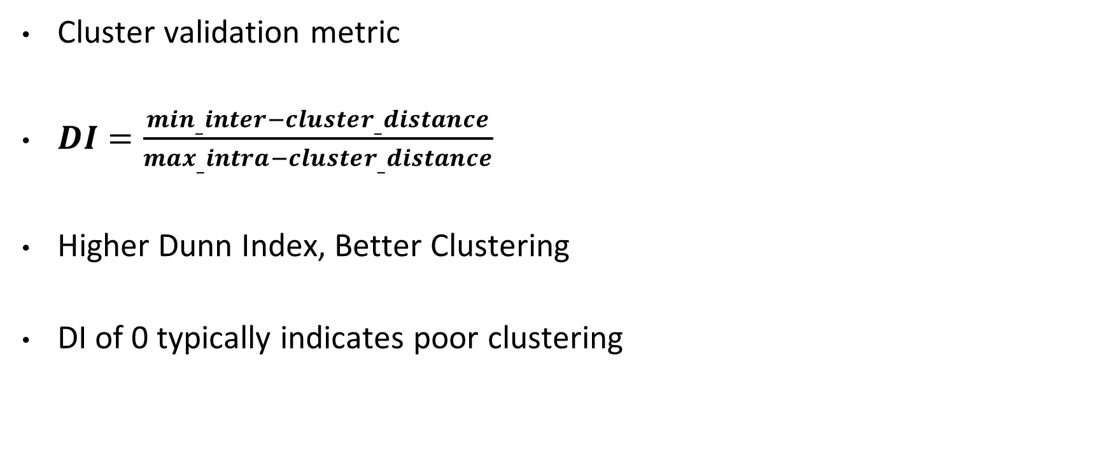
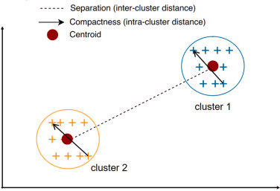
The Dunn Index (DI)

Slide 17
References
[1] Rajesh Khadka, “Machine Learning Types #2 - Towards Data Science,” Medium, Sep. 07, 2017. https://towardsdatascience.com/machine-learning-types-2-c1291d4f04b1
[2] J. C. Bezdek, Pattern Recognition with Fuzzy Objective Function Algorithms. Springer Science & Business Media, 2013.
‌[3] Witold Pedrycz, An Introduction to Computing with Fuzzy Sets. Springer Nature, 2020.
[4] “Day 71 - Fuzzy C-Means Clustering Implementation,” www.youtube.com. https://www.youtube.com/watch?v=W-3ZYGmLJ-4&list=PPSV (accessed Oct. 17, 2023)
[5] “Dunn index and DB index - Cluster Validity indices | Set 1,” GeeksforGeeks, May 09, 2019. https://www.geeksforgeeks.org/dunn-index-and-db-index-cluster-validity-indices-set-1/
[6] “Fuzzy c-means,” www.youtube.com. https://www.youtube.com/watch?v=zr50h_91gOw&ab_channel=jeff (accessed Oct. 20, 2023).
‌[7]“Day 70 - Fuzzy C-Means Clustering Algorithm,” www.youtube.com. https://www.youtube.com/watch?v=VhYt7nxOKKs&ab_channel=DataSciencewithSharan (accessed Oct. 20, 2023).
[8]“Fuzzy C Means Clustering Algorithm Solved Example | Clustering Algorithm in ML & DL by Mahesh Huddar,” www.youtube.com. https://www.youtube.com/watch?v=X7co6-U4BJY&t=230s&ab_channel=MaheshHuddar (accessed Oct. 20, 2023).‌

